Slide 1


Faculty of Computing and Informatics
Business Management Information Systems –
BMC511S
Lesson 3 – Information systems organisation and strategy

Slide 2
Faculty of Computing and Informatics
Information systems organisation and strategy
Features of organisations
Economic impact of information systems on organisations
Porter’s competitive forces model
Information systems strategies for dealing with competitive forces
The business value chain model

Slide 3
Faculty of Computing and Informatics
Features of organisations
An organisation is a group of people with a particular purpose, such as a business or government department
An organisation is a social unit of people that is structured and managed to meet a need or to pursue collective goals

Slide 4
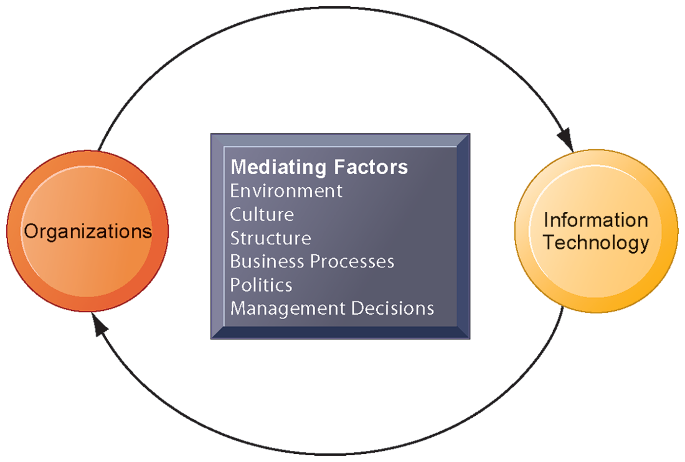
Faculty of Computing and Informatics
Features of organisations
The interaction between IT and organisations is influenced by mediating factors including the organisation’s structure, business processes, culture, politics, surrounding environment and management decisions

Slide 5
Faculty of Computing and Informatics
Features of organisations
An organisation’s environment – the forces or institutions surrounding an organisation that affect its performance, operations and resources. Organisations draw resources which supply goods and services from the environment, e.g. government, competitors, customers, financial institutions
An organisation’s culture are the assumptions that define the organisation’s goals and products, e.g., it is assumed that students attend university to learn
An organisations’s structure is a system used to define a hierarchy with an organisation. It defines each job, its function and where it reports within the organisation

Slide 6
Faculty of Computing and Informatics
Features of organisations
An organisation’s business processes are the routines for providing goods and services, e.g., the gathering of basic information
An organisation’s politics are the informal, unofficial behind-the-scenes efforts to sell ideas, influence an organisation, increase power and achieve other targets. These are struggles for resources, competition and using informal networks to gain power and accomplish tasks.
An organisation’s management structure determines the different activities and members and assigns roles, responsibility and authority to carry out different tasks

Slide 7
Faculty of Computing and Informatics
The economic impacts of information systems in an organisation
- IT as a factor of production that can be substituted for traditional labour. As labour costs increase, they can be substituted by IT
- As the cost of IT comes down, it substitutes other forms of capital such as buildings and machinery which are increasing
IT affects the cost and quality of information
IT reduces transaction costs – the costs incurred when a firm buys on the market place what it cannot make itself
Transaction cost theory – using markets is expensive because of locating and communicating with distance suppliers, monitoring compliance, buying insurance, obtaining information on products, etc

Slide 8
Faculty of Computing and Informatics
The economic impacts of information systems in an organisation
IT networks lower the cost of market participation (transaction costs) – firms contract external suppliers instead of using internal resources, meaning firms shrink in size by, for example, reducing the number of employees
IT reduces internal management costs
Agency theory – an organisation is viewed as a “nexus of contracts” i.e a comination of contracts, among self-interested individuals rather that as a unified profit-maximizing entity.
IT can reduce agency costs (the costs of supervising employees) , making it possible for firms to grow without adding to and without adding employees
IT reduces the cost of acquiring and analyzing information

Slide 9
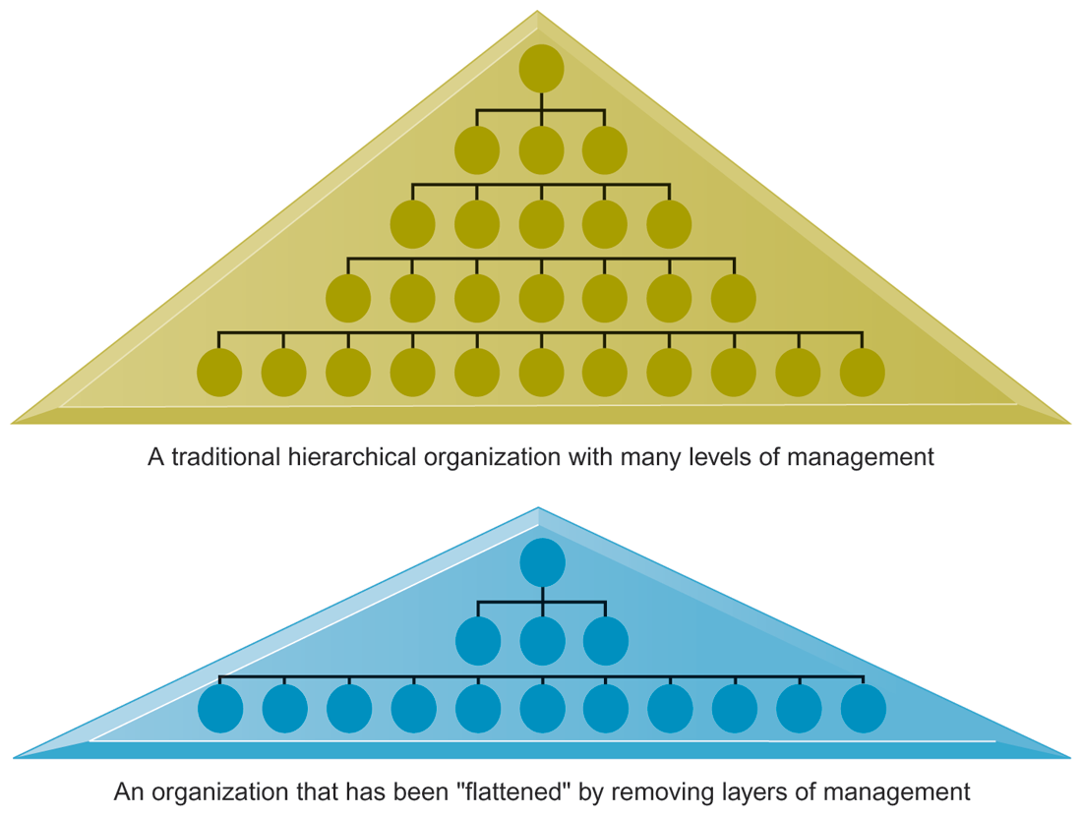
Information systems can reduce the number of levels in an organization by providing managers with information to supervise larger numbers of workers and by giving lower-level employees more decision-making authority.

Slide 10
Faculty of Computing and Informatics
Porter’s Competitive Forces Model
Michael Porter’s competitive forces model This is a model for understanding competitive advantage – a condition or circumstance that puts a company in a favorable or superior business position
Provides general view of firm, its competitors, and environment
  Five competitive forces shape fate of firm:
    Traditional competitors
    New market entrants
    Substitute products and services
    Customers
    Supplier
It allows a company to produce goods or services at a lower price or in a more desirable fashion for customers

Slide 11
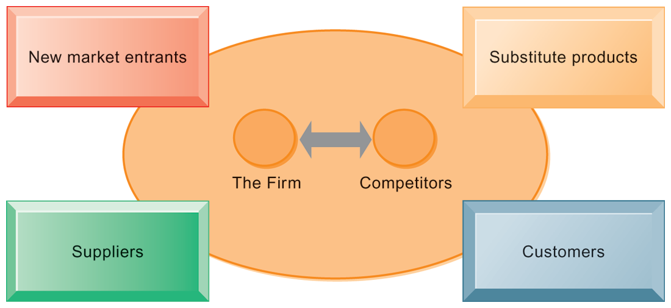
Faculty of Computing and Informatics
Porter’s Competitive Forces Model
The strategic position of a firm and its strategies are determined by its competitors and the environment which consists of new market entrants, substitute products customers and suppliers.

Slide 12
Faculty of Computing and Informatics
Porter’s Competitive Forces Model
Traditional competitors
  All firms share market space with competitors who are continuously devising new products, services, efficiencies, and switching costs.
New market entrants
  Some industries have high barriers to entry, for example, computer chip business.
  New companies have new equipment, younger workers, but little brand recognition.

Slide 13
Faculty of Computing and Informatics
Porter’s Competitive Forces Model
Substitute products and services
  Substitutes customers might use if your prices become too high, for example, iTunes substitutes for CDs
Customers
  Can customers easily switch to competitor's products? Can they force businesses to compete on price alone in transparent marketplace?
Suppliers
  Market power of suppliers when firm cannot raise prices as fast as suppliers

Slide 14
Faculty of Computing and Informatics
Information systems strategies for dealing with competitive forces
Low-cost leadership: Using IS to achieve the lowest operational costs and prices, e.g. point-of-sale terminals link to a central computer so that inventory can be replenished at lightning speed and there is no need to keep large stock in warehouses
Product differentiation: Using IS to make a product more attractive by contrasting its unique qualities with other competing products, e.g., packaging goods in a creative way, incorporating new functional features, new advertising campaigns or sales promotions

Slide 15
Faculty of Computing and Informatics
Information systems strategies for dealing with competitive forces
Focus on market niche: Using IS to enable a specific market focus and narrow the target market better than competitors, e.g., by producing and analyzing data for finely-tuned sales and marketing techniques
Customer and supplier intimacy: Using IS to develop strong ties and loyalty with customers and suppliers
Increase switching costs

Slide 16
Faculty of Computing and Informatics
Business value chain model
The model highlights the specific activities in the business where competitive strategies can be best applied and where information systems are most likely to have a strategic impact
It has critical leverage points where a firm can use IT to enhance its competitive position
The model is subdivided into primary activities and support activities
The primary activities are related to the production and distribution of the firm’s products and services which create value for the customer, i.e. inbound logistics, operations, outbound activities, sales and marketing and services
The support activities make the delivery of the primary activities possible, i.e. administration and management, human resource management, technology development and procurement

Slide 17
Faculty of Computing and Informatics
Business value chain model
  Support activities
Administration and management
Human resource management
Technology development
Procurement
  Primary activities
Inbound logistics e.g. warehousing
Operations, e.g. CAD
Sales and marketing, e.g. ordering systems
Outbound logistics, e.g. shipment scheduling
Services e.g. equipment maintenance

Slide 18
Faculty of Computing and Informatics
Business value chain model
Primary activities
  Inbound logistics – receiving and storing materials from distribution to production, e.g. receiving, storing, inventory control, transportation
  Operations – inputs into finished goods, e.g. machining, packaging, assembly
  Outbound activities – entails storing and distributing finished products to customers, e.g., warehousing, order fulfilment, distribution, transportation
  Sales and marketing – getting buyers to purchase products or promoting and selling the firm’s products including advertising, promotion, pricing
  Services – maintenance and repair of the firm’s goods and services, e.g., customer support, repair services, installation, training, spare parts management, upgrading

Slide 19
Faculty of Computing and Informatics
Business value chain model
Support activities
  Procurement – procurement of raw materials, servicing spare parts, buildings, machines, etc.
  Technology development – includes development of technology to support the value chain activities such as research and development, process automation, design, redesign
  Human resource management – activities associated with recruiting, development (education), retention and compensation of employees and managers
  Administration and management – includes general management, planning management, legal, finance, accounting, quality management

Slide 20
13 Storch Street
Private Bag 13388
Windhoek
NAMIBIA
T: +264 61 207 2258
F: +264 61 207 9258
E: fci@nust.na
W: www.nust.na
Faculty of Computing and Informatics
Thank You.

